Slide 1
Dedicated to the comprehensive development of urban, marginalized areas in Perú through sustainable social programming in: Education, Employment & Entrepreneurship, Housing, Healthcare, Humanitarian & Food Aid, Youth Development, Local Volunteering, Water Sanitation.
Coprodeli
2012 RECAP

Slide 2
Programs & Intervention Areas

Slide 3
Programs
Coprodeli runs social programs in partnership with state institutions, foreign aid, socially responsible corporations, and individual sponsors contributing to the integral development of urban marginalized areas in Peru:
Education – 16 Schools - 5,850+ students
Preventive Health – 6 Medical Centers, 11 Health Clubs - 65,000 medical consultations/year
Humanitarian & Food Aid – Aid distribution – 1,100,000 meal rations/year
Children at High Risk – 6 Outreach Centers serving 1,000 children – 46 with USA Padrinos
Employment / Entrepreneurship – 2 Industrial Parks supporting 100 small businesses, 3 Vocational schools with 1,500 students/year
Housing – 1,200+ homes constructed
Spiritual Guidance – A faith-based values curriculum taught in the Centers and Schools
Volunteering – 200 local and 70 international volunteers per year

Slide 4
Areas of Intervention
Pachacutec: B, C, E, F – Ventanilla – Callao
Gambetta, 200 Millas, Sarita Colonia – Callao
San Luis – San Luis – Cañete – Lima Sur
San Pedro – Chincha Baja – Chincha – Ica
Nuestra Señora de las Americas – Pisco – Ica
San Antonio, Subtanjalla – Ica – Ica
Nazca – Ica
Corpus Cristi de Bellavista – Bellavista - San Martín

Slide 5
Education Program
In Numbers
Elements & Innovations
Accomplishments
Graduates

Slide 6
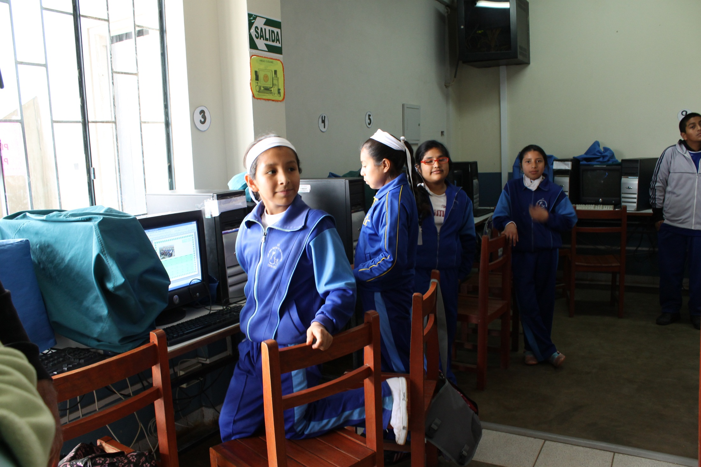
Computer Workshop
San Juan Macías School
Sector C, Pachacutec

Slide 7
Education Program In Numbers
Callao & Pachacutec
3,109 students, pre-k through High School
3 schools in Callao, 4 schools in Pachacutec
Schedule: 7:45 am to 5:00 pm
South: Cañete, Chincha, Pisco, Ica
2,500 students, pre-k through HS
4 schools, 1 in each city
Jungle: San Martín
250 students
1 ‘Agriculture School’

Slide 8
Education Program In Numbers
56,023 students served in 16 schools
Collaboration with State-run public schools
Coprodeli High Schools
Coprodeli Elementary Schools
Coprodeli Pre-K and Kindergarten

Slide 9
Education Program Elements & Innovations
Rigorous Coprodeli-developed curriculum
Professors and principals highly motivated and committed to the learning process
High-quality learning materials
Daily nutritious lunches and snacks for students
1,120 hours of professional and entrepreneurial training
On-site libraries
Multi-learning style teaching: For visual, audio, and participation learners
Courses and workshops for teachers to keep class syllabi up to date
Mandatory parental participation to encourage involvement and pride in children’s education
Parents’ Schools, Volunteer Hours

Slide 10
Education Program Accomplishments
Coprodeli Callao School ‘Agustín de Hipona,’ established in 1994, has advanced the children of the most marginalized families in Perú. It was recently recognized as the
#1 school in the region #5 school nationwide

Slide 11
Education Program Graduates
Coprodeli graduates:
Enter into a Coprodeli graduate association
Have access to college scholarships
Have access to reserved job opportunities
Of the 256 graduates of 2011-2012,
52% are preparing for university
20% are studying at a technical institute
20% are studying at college
8% are working

Slide 12
Preventive Health & Humanitarian Aid
Preventative Health
Humanitarian Aid
Nutritional Aid

Slide 13
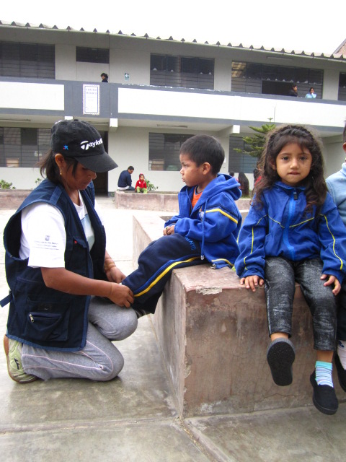
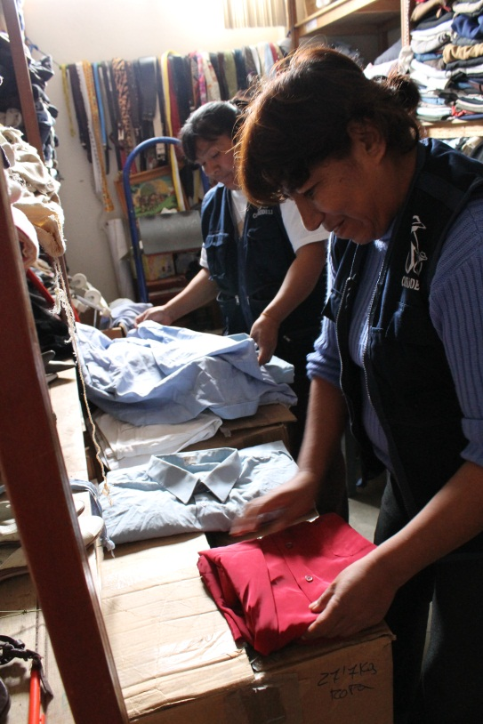
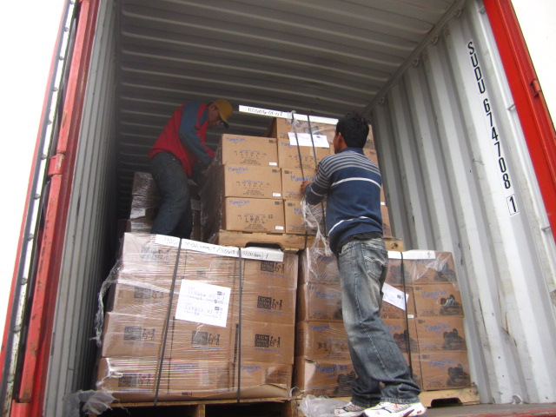
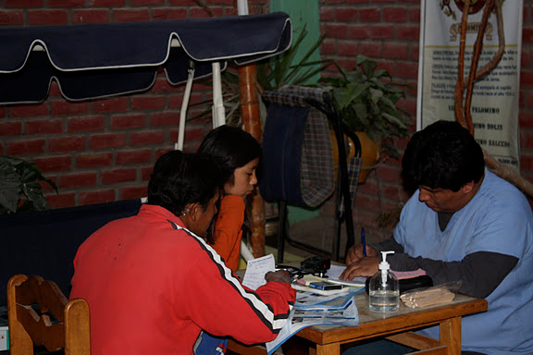
Preventive Health
&
Humanitarian Aid
Serving over 65,000 people per year

Slide 14
Preventive Health
4 clinics offering quality general and specialized medical services
Attended to 65,000 patients in 2012
95 medical campaigns in the Southern regions, performed by teams of Spanish and Peruvian doctors

Slide 15
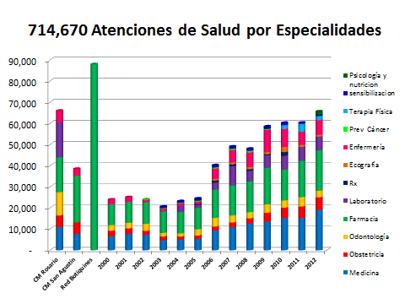
Preventive Health
Over the past 20 years, Coprodeli clinics have attended to 714, 670 patients
Psychology and nutrition
Awareness
Physical Therapy
Cancer prevention
General nursing
Sonograms
X-rays
Lab work
Pharmacy
Dental health
Obstetrics
General medicine

Slide 16
Preventive Health
11 ‘Health Clubs’:
Friendship Club
Healthy & Happy Family Club
Healthy Lifestyles Club
Active Elderly Club
161 participants, serving those who:
Have suffered interfamilial violence
Are chronically ill
Are physically disabled
Are otherwise isolated from society or have limited social capital
Mental Health Clinic
20 mental health patients suffering from retardation, schizophrenia, or other pyschological problems receive daily therapy and care

Slide 17
Humanitarian Aid
Benefits the poorest of the poor who are making long-term efforts to work out of their poverty but still cannot get ahead
Clothes, shoes, school supplies, and food supplies
Since 1989, Coprodeli has served 1,301,069 people in the Humanitarian Aid program – 122,479 in 2012 alone

Slide 18
Nutritional Aid
Coprodeli provides nutritious lunches and snacks in 16 school cafeterias and 6 Outreach Centers
Reaches approx. 6,000 children a year
757,680 rations given throughout each year
Since 1989, Coprodeli has given 34,994,400 rations of food (Coprodeli began primarily as a food aid organization)
Partners that make Nutritional Aid possible:
Coprodeli currently partners with FMSC to bring 48,000 kg of rice and soy to Coprodeli schools and programs annually.
Coprodeli has previously partnered with USAID’s Food for Peace program

Slide 19
Children In High Risk

Slide 20
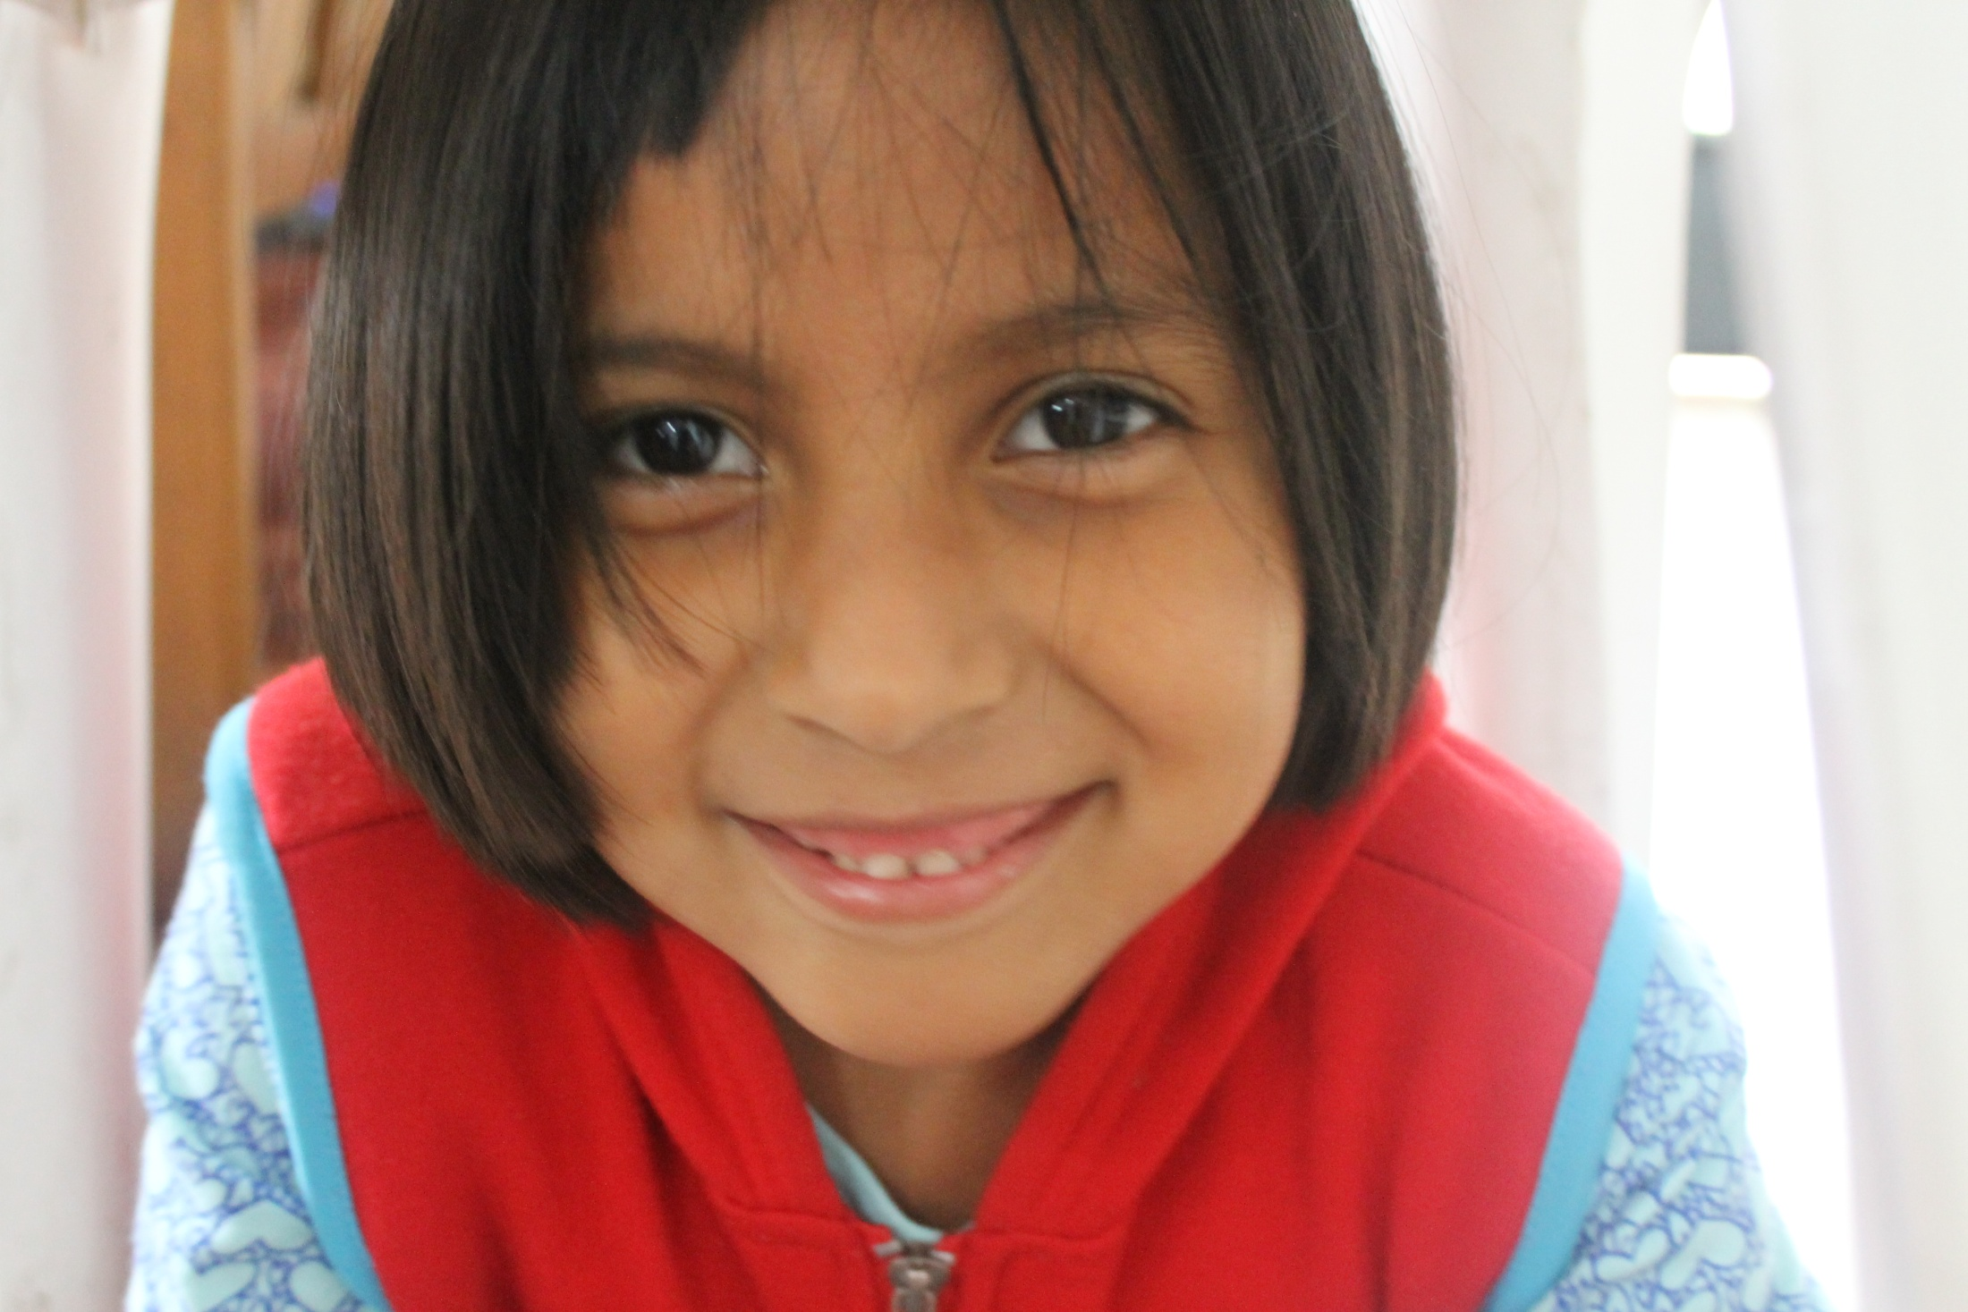
Jennifer (6) Children at High Risk Program
Notes:
Tapia Calle
Jennifer

Slide 21
Children In High Risk
730 youth receive daily nourishment, education, clothes, psychological attention, and family support
6 “CAE” Outreach Centers
9 Coprodeli schools with programs specifically aimed at children in high risk
9,536 children in high risk served since 1994

Slide 22
Employment Generation
Technical Learning
Microenterprise Incubation

Slide 23
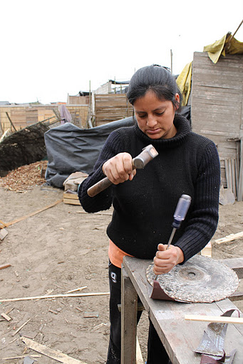
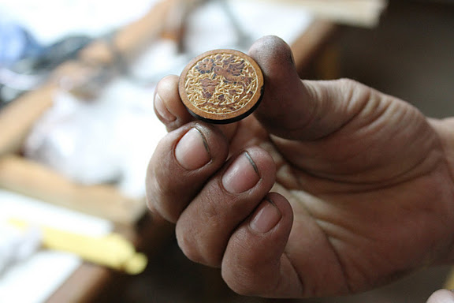
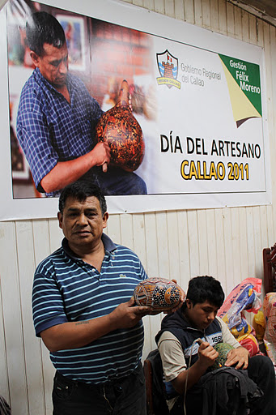
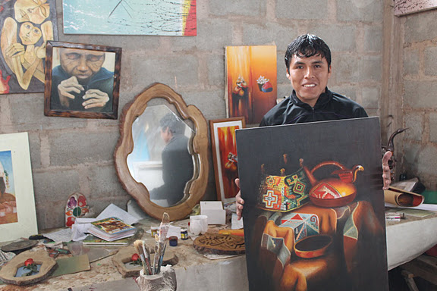
Industrial Park
Sector E, Pachacutec

Slide 24
Employment Generation Technical Learning
3 Technical Learning Centers
1,338 youth technically trained per year in a wide range of specialties (including electrical studies, graphic design, accounting, nursing, and baking, among others)
In Coprodeli schools:
434 students in 9th, 10th, and 11th grade participate in a ‘Workshop School’ which means that…
Students graduate with certification of 1,120 hours in baking, electrical studies, sewing, business administration, artisan crafts, and nursing

Slide 25
Employment Generation Technical Learning
Electrical Studies
Graphic Design
Accounting
Metal Carpentry
Wood Carpentry
Sewing
Nursing
Pharmacy
Computation
Cosmetology
Baking

Slide 26
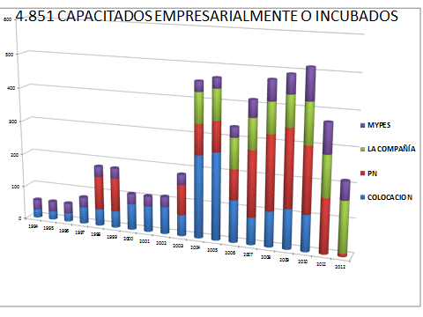
Employment Generation Microenterprise Incubation
Industrial Park (Microenterprise Incubation Center) in Ica
51 microenterprises will be established and launched
300 jobs will be created
Junior Achievement Program
Juniors in High School create microenterprises of their choosing and run company from business plan, to production, to liquidation
4,851 Entrepreneurially Trained or Incubated
Microenterprises
Junior Achievement
Small enterprises
Market Placement

Slide 27
Habitat Program
Building Public Infrastructure
Legal Property Ownership Formalization
Housing Construction

Slide 28
Habitat Program Building Public Infrastructure
5 projects of water, sewage, road creation and pavement, and electricity complete in the Southern Region, 1 project underway in the San Martín jungle
1 large well produces 70L of potable water per second, serving 5,000 people

Slide 29
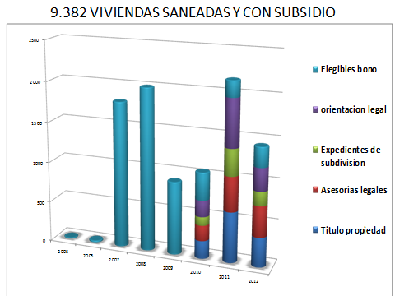
Habitat Program Legal Property Ownership Formalization
Eligible for government grant
Legal guidance
Paperwork for housing development
Legal assessments
Property title

Slide 30
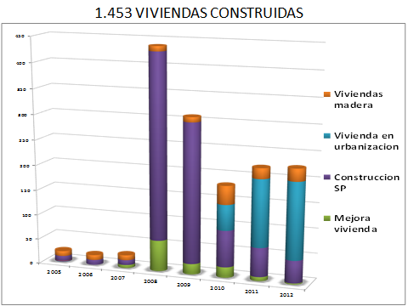
Habitat Program Housing Construction
Reconstruction of 1453 Homes (prior to natural disasters)
1,300 houses built within a Housing Development
Wood houses
Homes in a housing development
Reconstruction in a focused site
Housing improvements

Slide 31
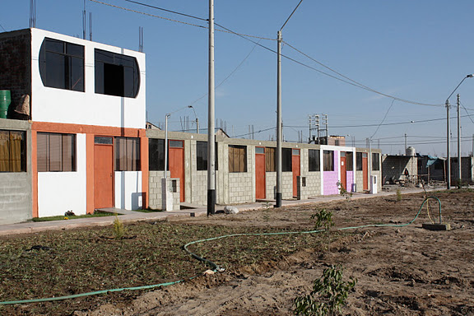
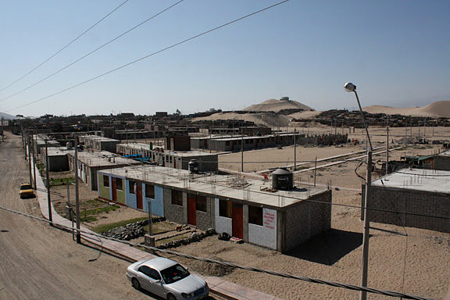
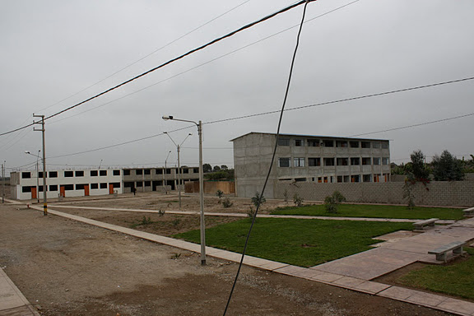
ICA & CHINCHA
URBANIZATIONS
CONSTRUCTING 1500 HOMES

Slide 32
SAN ANTONIO URBANIZATION – SUBTANJALLA, ICA 800 HOMES, PRE thru HIGH SCHOOL, 70 MICROENTREPRENEURIAL INDUSTRIAL LOTS, GREEN SPACES, WATER SANITATION PLANT, MEDICAL CENTER, YOUTH DEVELOPMENT CENTER

Slide 33
Financial Review

Slide 34
Financial Review
Income | 2012 | %
Autonomous Governmental Subsidies | $5,473.25 | 0,89%
Municipality Governmental Subsidies | $40,327.32 | 6,58%
Total public income | $45,800.57 | 7,48%
Institutions and business | $1,806.39 | 0,29%
Partners and donors | $309,028.37 | 50,44%
Humanitarian Aid | $69,878.45 | 11,41%
Income from ‘Just Commerce’ Program | $166,678.04 | 27,20%
Intereses y extraordinarios | $19,491.25 | 3,18%
Total private income | $566,882.50 | 92,52%
Total | $612,683.07 | 100,0%
Between 2010 and 2011, Coprodeli’s established international aid funding sources decreased to 7.48% from what it had received from the prior four years, largely due to the economic crises and organization of international aid funds.
This left Coprodeli’s ongoing projects without the funds necessary to complete them as planned.
Expenses | 2012 | %
Program Development Cooperation | $137,614.01 | 20,06%
Children at High Risk Program | $223,833.51 | 32,63%
Awareness | $7,524.96 | 1,10%
Humanitarian Aid | $60,064.91 | 8,76%
‘Just Commerce’ Program | $187,083.97 | 27,27%
Total Mission | $616,121.37 | 89,82%
Personnel | $51,102.65 | 7,45%
Administration | $18,720.82 | 2,73%
Total Management | $69,823.47 | 10,18%
Total | $685,944.84 | 100,0%
Net | $(73,261.77)

Slide 35
Partnerships
Over the years, COPRODELI Perú & Coprodeli USA have partnered with:
Non-Governmental International Aid Foundations & Agencies
U.S. Government Entities
Private Companies & Institutions
Esteemed U.S. Universities

Slide 36
Partnerships
Non-governmental International Aid Foundations & Agencies
U.S. Government Entities
Inter-American Development Bank
Kellogg Foundation
Pan-American Development Foundation
Feed My Starving Children
Koch Foundation
USAID Food for Peace
USAID Humanitarian Aid Freight Grants
US General Services Administration (GSA): Limited Excess Property Program
Peace Corps
CFC Campaign
Inter-American Foundation (Ica)

Slide 37
Partnerships
Private Companies & Institutions
Esteemed U.S. Universities
TOMS Shoes
Proctor & Gamble
US Bishops Association
The Bozzuto Group
Stern Cassello Associates
BOYANCI Wines
Brassfield Winery
Deloitte
Royal Caribbean
University of Notre Dame
University of Johns Hopkins
University of Virginia
George Washington University
American University
Indiana University

Slide 38
Priority Projects for 2013

Slide 39
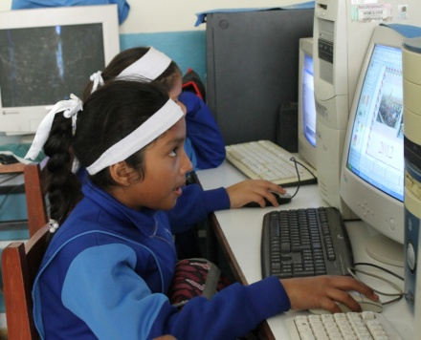
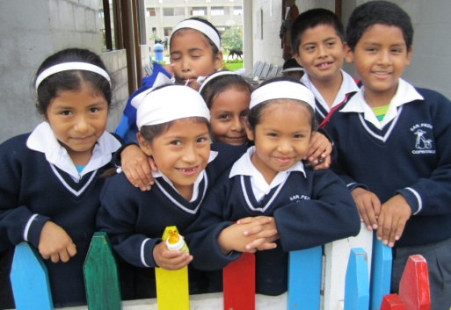
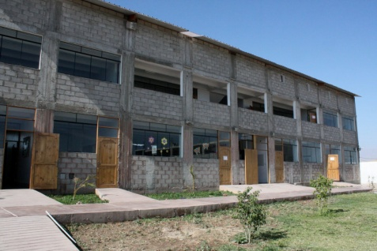
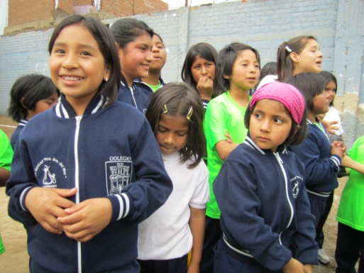
Priority Projects for 2013
CAÑETE SOCIAL CENTER PROJECT:
$200,000 to complete construction of high school, humanitarian aid offices, and chapel
PISCO HIGH SCHOOL:
$125,000 to build the high school
SAN MARTÍN JUNGLE FARM SCHOOL:
$138,667 to finish the elementary school, cafeteria, and library
PACHACUTEC SCHOOL:
$26,630 to finish the final Santa María classroom and workshop

Slide 40
We appreciate your support!

Slide 41
Thank you!

